Slide 1
Presentation
Timing
Diagram
Bikram Gyawali

Slide 2
Introduction to 8085 Microprocessor
It is 8 bit microprocessor introduce by intel in 1976.
It has a Accumulator and 6 general purpose register
It operates with a single +5V power supply.
It has clock speed range from 3MHZ to 6 MHZ
Notes:
Microprocessor is a programmable electronic chips that have computing and decision making capacity similar to CPU of computer
6 General Puprose register are B C D E H L
The 8085 microprocessor has an 8-bit data bus and a 16-bit address bus, which allows it to access up to 64 KB of memory.

Slide 3
Introduction to Timing Diagram
Timing diagram is a graphical representation. It represent the execution time taken by each instruction.
The 8085 microprocessor has a set of control signals and data signals that play an important role in the execution of instructions
Terms Related to Timing Diagram
Clock Cycle
Machine Cycle
T-state
Control Signal
Notes:
Control signals such as RD (Read) and WR (write),M/IO,INTAetc
And data signals are Address bus AD0 to AD7
The time required to execute an instruction is called a clock cycle.
The time required to access memory or input/output devices is called a machine cycle. The 8085 has 5 basic machine cycles i.e., opcode fetch (4T), memory read cycle, memory write cycle, read I/O cycle, and write I/O cycle.
A machine cycle and an instruction cycle take several clock periods. The portion of an operation performed in one system clock period is called a T-state.
The control signal controls the operations

Slide 4
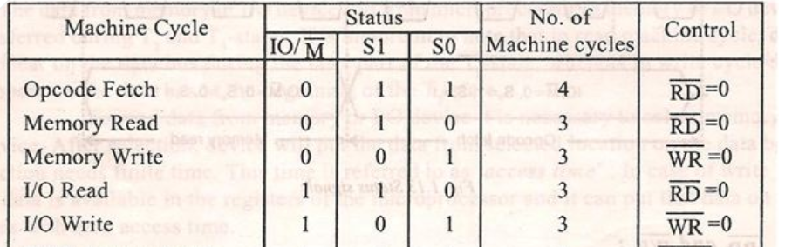
Machine Cycle Status and Control Signals

Slide 5
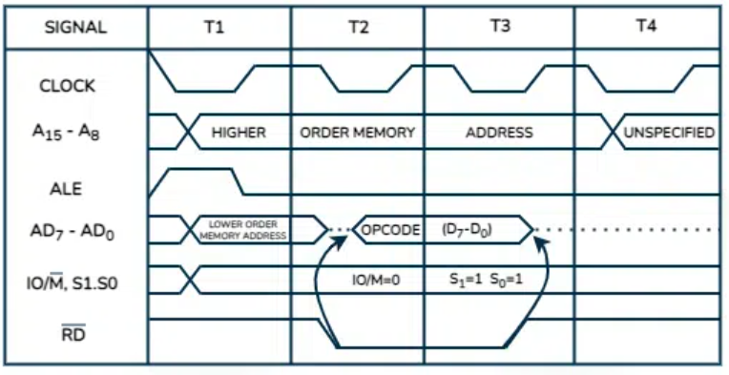
Timing Diagram of Opcode Fetch Cycle
Notes:
Reason of unspecified memory address in the t4 stage
We known opcode has 4 state of memory address :read ,fetch ,decode and execute
Execution is in the t4 stage
We don’t require any memory address for execution that’s why t4 is unspecified
The cross indicate that combination of 0 and 1 because any address is the combination of 0 and 1.
When the ALE is 1 or high it work as address bus (AD7-Ad0) and when it is 0 it works as data bus (D0-D7)
For fetching the address { lower significate (AD7-AD0) }the ALE is one in T1 state and 0 in other state
STA 2050H (opcode of STA is 32)

Slide 6
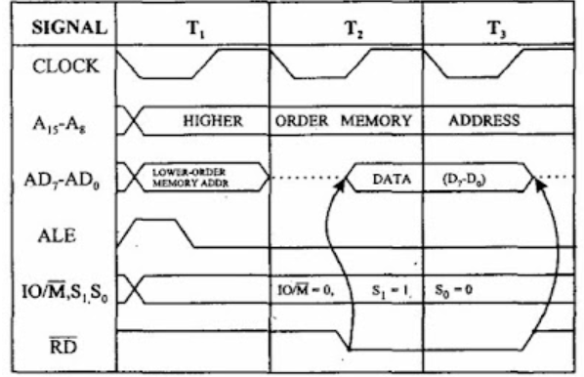
Timing Diagram for Memory Read
Notes:
We need the memory read cycle when there are 2 bit data
In MVI B,07H we need memory read because it has 2 bit first one is opcode of MVI B (06h) and another is data to be load 07h
MVI B ,07 H
06,07H
Address CO50H
HOA=most significant bit (C0)
LOA= least significant nit (50H)

Slide 7
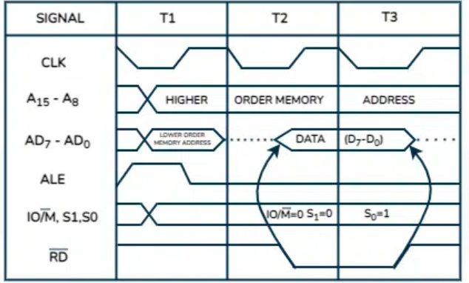
Timing Diagram for Memory Write
Notes:
STA C050H (opcode of STA is 32)
32,C050H
We will store the content of accumulator to the CO5OH memory address

Slide 8
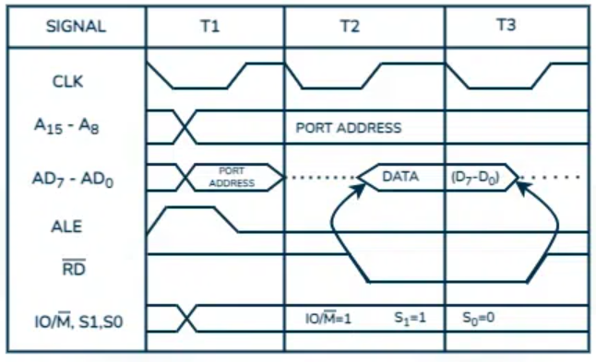
Timing Diagram of IO read
Notes:
IN 8-bit port Address
IN is used to load the content of the input port to accumulator
IN 8CH
Opcode DB
DB 8CH
data is DB

Slide 9
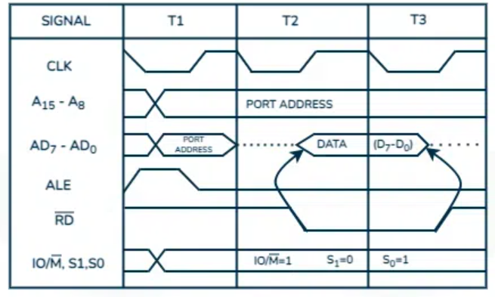
Timing Diagram of IO Write
Notes:
OUT 8 bit port address
Out is used to copy or write the content of accumulator to the I/O port
OUT F8H
Opcode of out is D3 means
D3 F8H

Slide 10
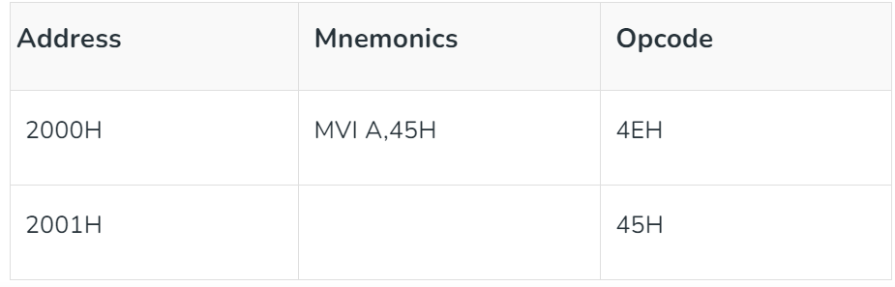
Timing Diagram for MVI A,45
Notes:
Loading opcode 4EH from memory 2000H. (Operation Code Loading Machine Cycle)
Read (move) data 45H from memory 2001H. (memory reading).

Slide 11
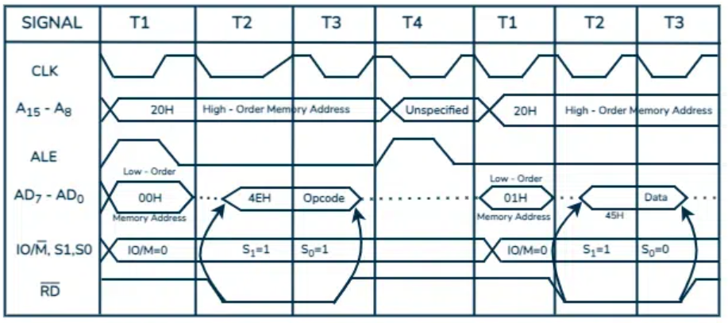
Notes:
Loading opcode 4EH from memory 2000H. (Operation Code Loading Machine Cycle)
Read (move) data 45H from memory 2001H. (memory reading).

Slide 12
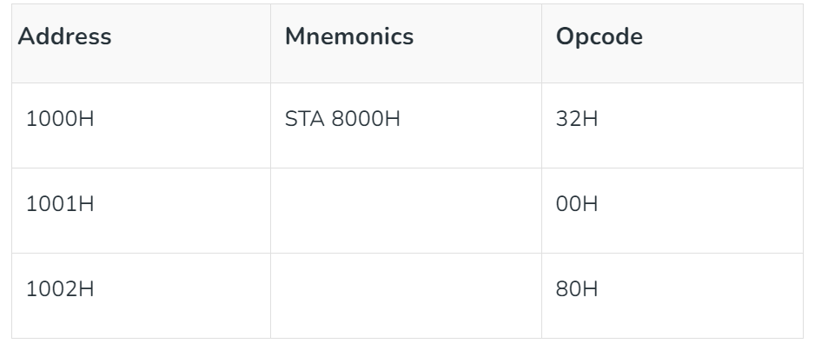
Timing Diagram for STA 8000H
Notes:
STA stands for Store Accumulator – the contents of the accumulator are stored at (1000H).
The opcode code of STA indicates 32H. It is provided by 1000H memory (see picture). – In the machine cycle.
Then read the sub address (00). – Memory reading machine cycle
Read higher memory location (80) – Memory read machine cycle.
Consider the combination of the two addresses and write the details of the accumulator for 8000.

Slide 13
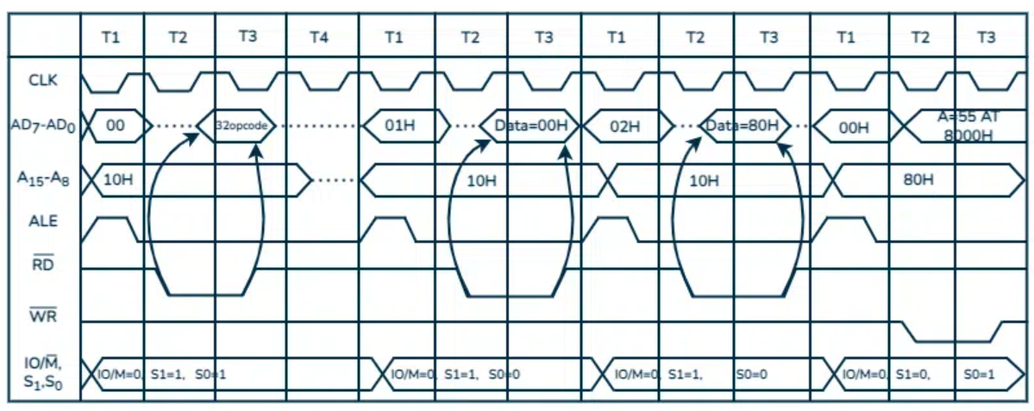
Notes:
STA stands for Store Accumulator – the contents of the accumulator are stored at (1000H).
The opcode code of STA indicates 32H. It is provided by 1000H memory (see picture). – In the machine cycle.
Then read the sub address (00). – Memory reading machine cycle
Read higher memory location (80) – Memory read machine cycle.
Consider the combination of the two addresses and write the details of the accumulator for 8000.

Slide 14
Timing Diagram of INR M Instructions
C500H INR M 34H
D050 as memory address
E1H and E2H as data
Steps :
Opcode Read
Memory Read
Memory Write
Notes:
In the address C500H the INR instruction is performing but the data is in the another location as D050 34 H is the opcode of INR M
The D050 content the data E1
Then INR is use to increase the content of memory D050 by 1 which means the content increase from E1 to E2 and we again write the increase content in the same location

Slide 15
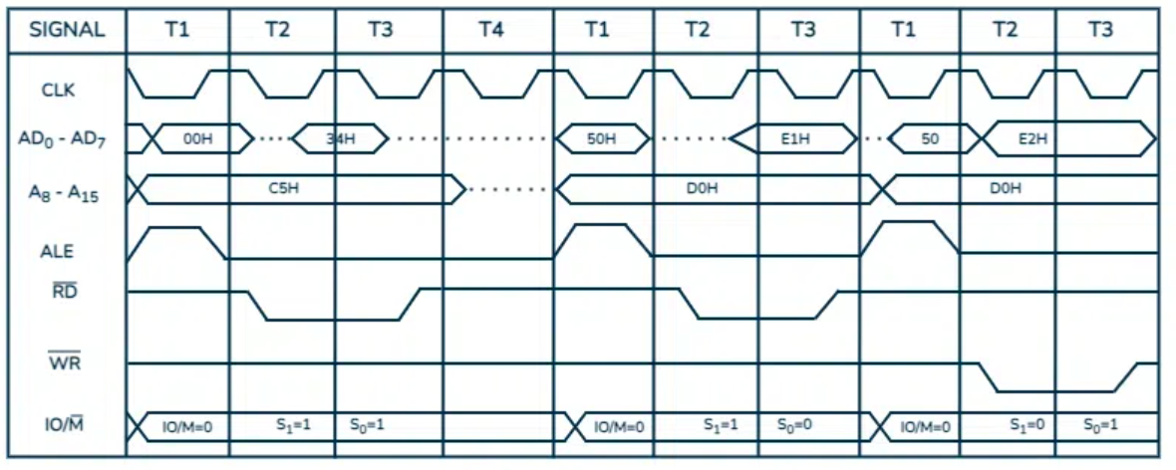
Notes:
In the address C500H the INR instruction is performing but the data is in the another location as D050 34 H is the opcode of INR M
The D050 content the data E1
Then INR is use to increase the content of memory D050 by 1 which means the content increase from E1 to E2 and we again write the increase content in the same location

Slide 16


Lets clear Your Queries

